Slide 1
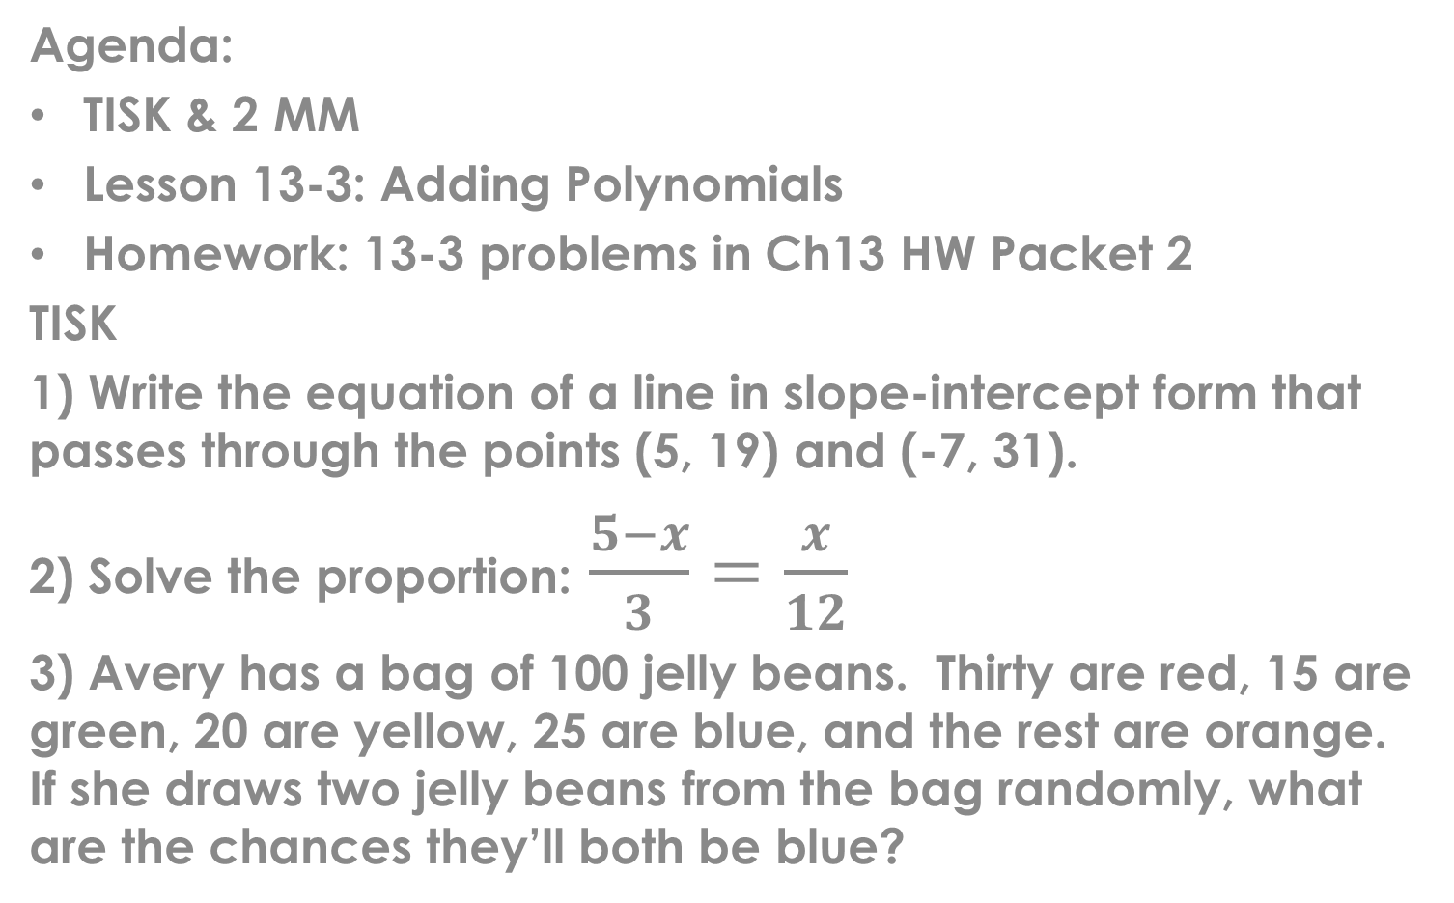
Tuesday, Feb. 12, 2013
Agenda:
TISK & 2 MM
Lesson 13-3: Adding Polynomials
Homework: 13-3 problems in Ch13 HW Packet 2
TISK
1) Write the equation of a line in slope-intercept form that passes through the points (5, 19) and (-7, 31).
2) Solve the proportion: $\frac{5−x}{3}=\frac{x}{12}$
3) Avery has a bag of 100 jelly beans. Thirty are red, 15 are green, 20 are yellow, 25 are blue, and the rest are orange. If she draws two jelly beans from the bag randomly, what are the chances they’ll both be blue?
Notes:
Mental Math
1.) Start with the product of 8 and 17. (136) Add 57. (193) Subtract 215. (-22) Add 13. (-9) Write the absolute value of your answer. (9)
2.) Start with the product of 62 and 7. (434) Add the opposite of 213. (221) Increase your answer by 4. (225) Divide by 5. (45) Add 19. (64) Take the square root. (8) Write your answer.

Slide 2
§13-3 Adding Polynomials
When you add polynomials you must add like terms only!
You may do so vertically or horizontally.

Slide 3
Let’s see that vertically:

Slide 4
Your Turn!

Slide 5
Try another!

